Slide 1

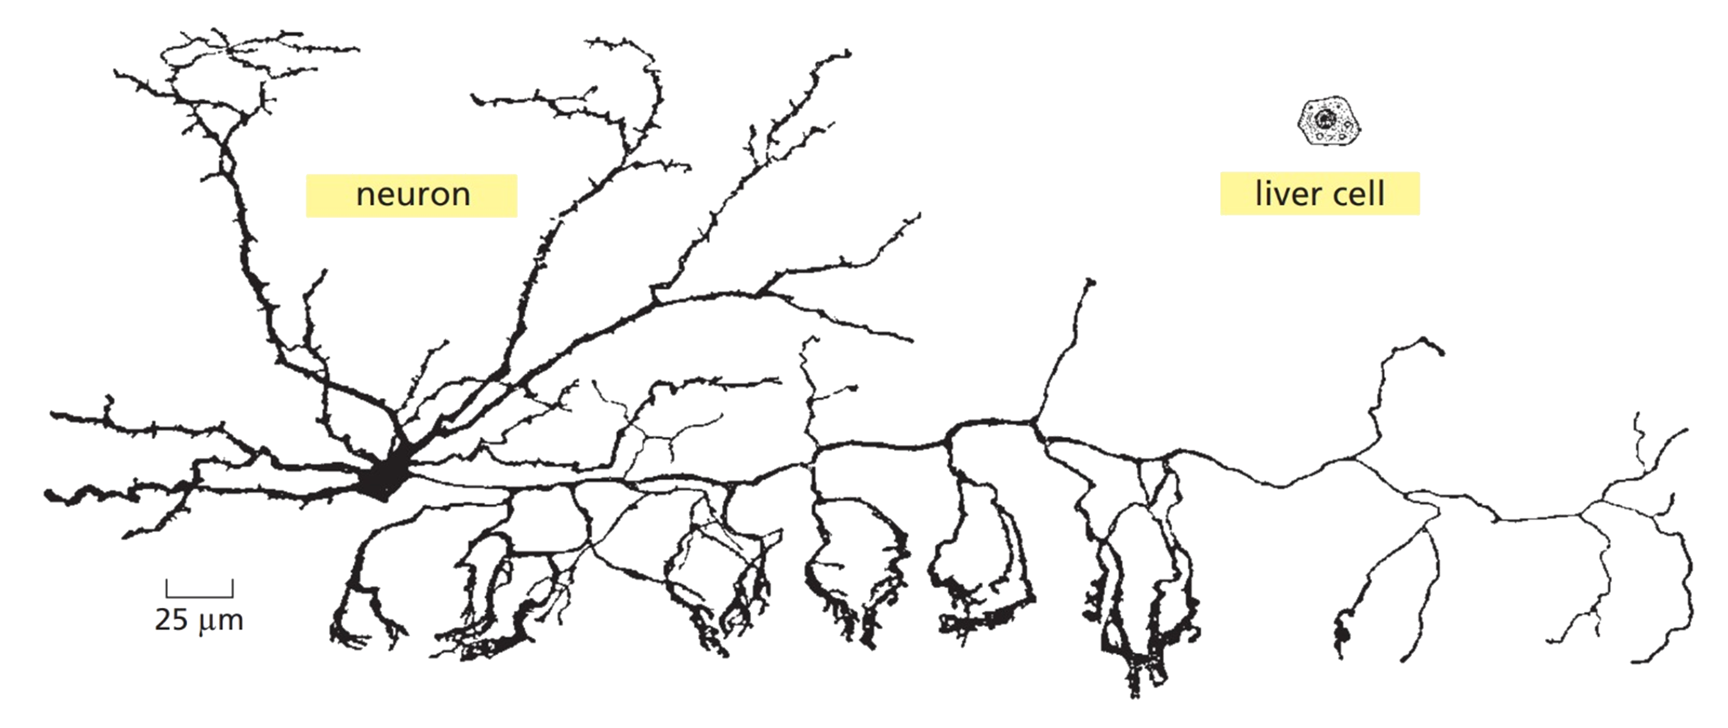
Notes:
It’s quite interesting how a single cell turns into a complex multicellular individual like a human being.
Each tissue of this individual has cells with different morphologies and functions.

Slide 2
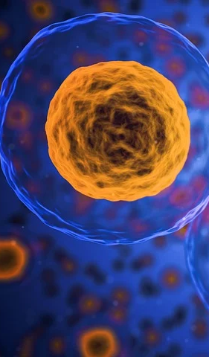
Gaining inside on human early organogenesis through
TRA expression analysis

Slide 3




Structure
Background
Dataset
Hypothesis
Timeline

Slide 4




Background

Slide 5
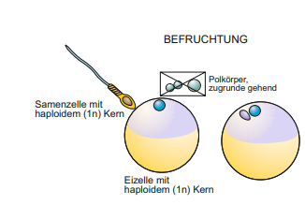
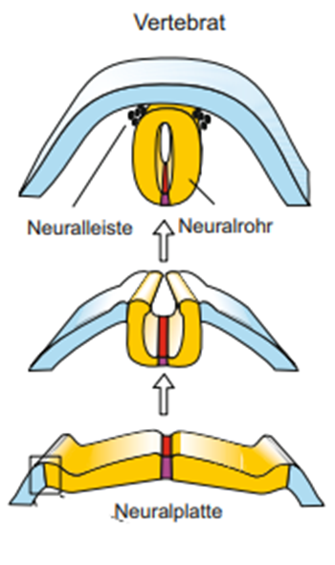
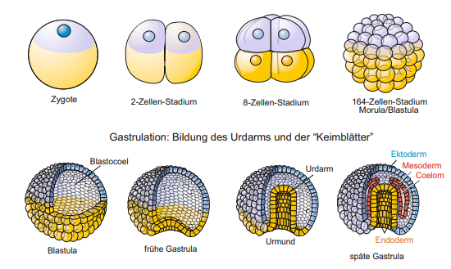
Embryogenesis
Fertilization
Neurulation
Rapid cell division
Gastrulation
Entwicklungs-und Reproduktionsbiologie, Müller 2018
Notes:
And those tissues develop during Embrygenesis.
The whole process starts with the fertilization of an egg by sperm.
As a result, the fertilized egg gets into a process of rapid cell devisions, which led to the creation of the Blastula.
The three germ layers ectoderm, mesoderm and endoderm are created during Gastrulation.
Neurodermal tissues from the ectoderm differentiate to the neuronal plate. The neuronal plate closes and creates the neuronal tube.

Slide 6
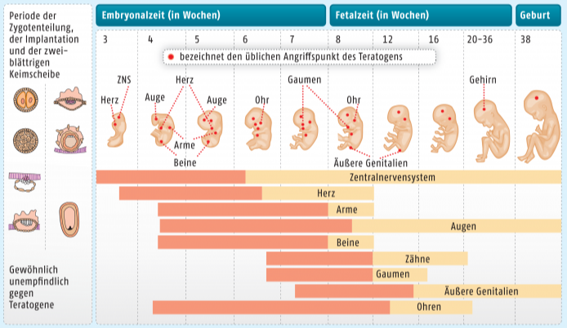
Embryogenesis
Organogenesis
https://www.deutsche-apotheker-zeitung.de/daz-az/2016/daz-20-2016/abraten-oder-zustimmen
Notes:
The organs are created during week 3 to 12 in organogenesis. Especiallay the brain develops in this time.
At week 4: the neural tube closes and the heart starts to beat and first structures like arm buds develop.
The brain of the fetus grows during the next weeks and the Prosencephalon develops to the Diencephalon and Telencephalon. Furthermore the morphology of the embryo changes.
Major parts of the brain are developed at week 9.
Many signals influence the development of the brain e.g. chemokines.

Slide 7
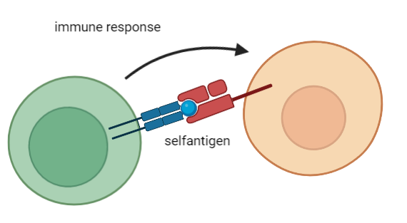
Tissue restricted antigens (TRAs)
Genes for self-antigens
Genes which are expressed more than 5x the median in less than 5 tissues
Biorender by Joshua Eigenmann
Notes:
Another important issue are TRAs
Functional immune cells are necasssary to prevent infections
Shouldn’t react against selfantigens -> negative control in thymus
Medullary thymic epithelial cells (mTECs) present slef-antigens on their surface, reacting immune cell will be removed
Tissue restricted antigens (TRAs) code for selfantigens
TRAs are ordered in cluster which are controlled by the transcriptionfactor Autoimmune Regulator (AIRE)
Genes more than 5x the median in less than 5 diffrent tissues expressed

Slide 8
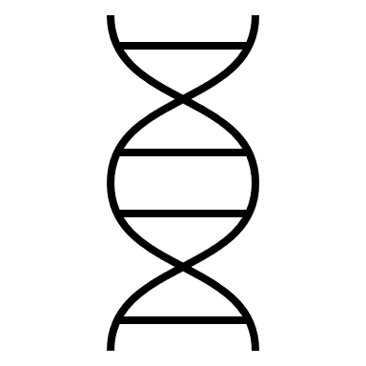
Dataset

Slide 9
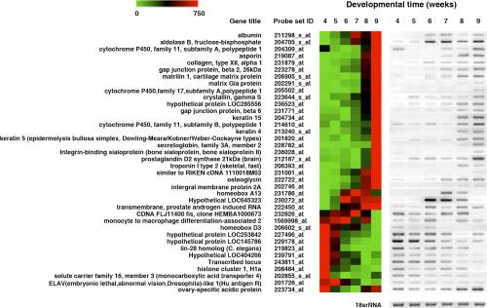
Dataset: GSE15744
Title: Gene Expression Atlas for Human Embryogenesis
Gene expression data of three embryos for weeks 4-9 of embyrogenesis
Dataframe with 18 microarrays and 54,675 gene expression values
Original paper identified 28,761 expressed genes, 5,358 are differentially expressed
Yi H, Xue L, Guo MX, et al. Gene expression atlas for human embryogenesis. (2010)
Notes:
We chose the dataset “gene expression atlas for human embryogenesis" from the gene expression omnibus. It contains transcriptome data of three individual embryos each week for six weeks between the forth and nineth week of embryogenesis. Hence we have a dataframe of 18 microarrays with about 54000 expression values.
The original paper identified about 29000 Genes highly expressed, 5000 of them change significantly in those 6 weeks. On the heatmap you can see some prominent genes listed with their expression data

Slide 10
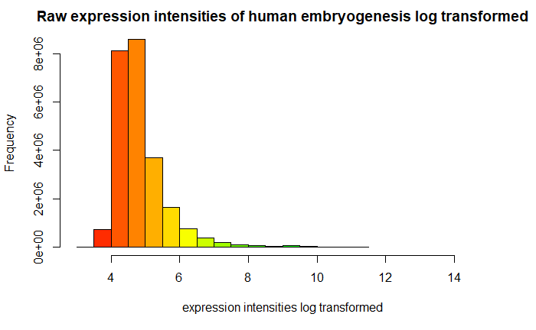
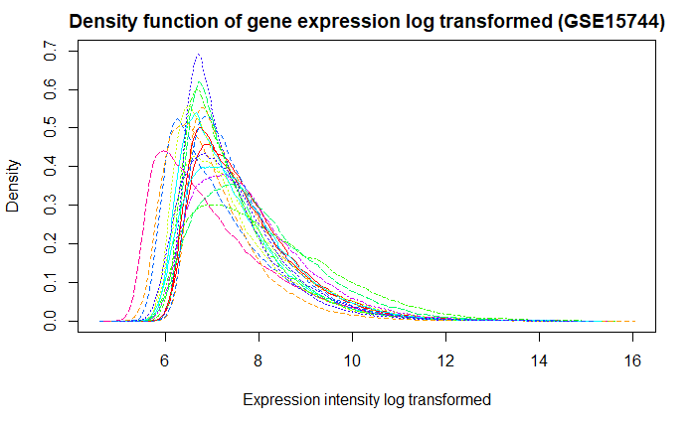
Dataset: Gene expression intensity
Title: Gene Expression Atlas for Human Embryogenesis
Gene expression data of three embryos per week 4-9 of embyrogenesis
Dataframe with 18 microarrays and 54,675 gene expression values

Slide 11
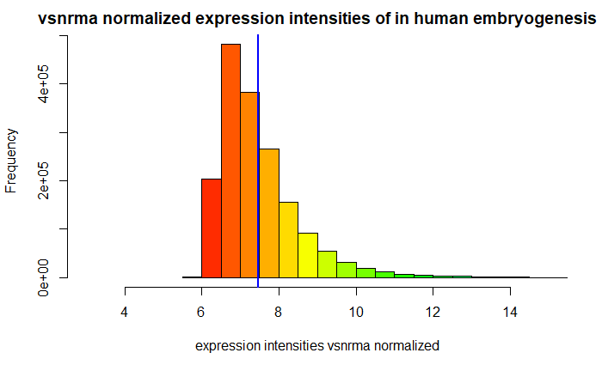
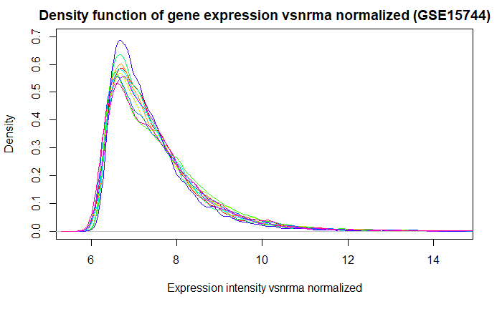
Dataset: vsn rma normalized
Title: Gene Expression Atlas for Human Embryogenesis
Gene expression data of three embryos per week 4-9 of embyrogenesis
Dataframe with 18 microarrays and 54,675 gene expression values

Slide 12
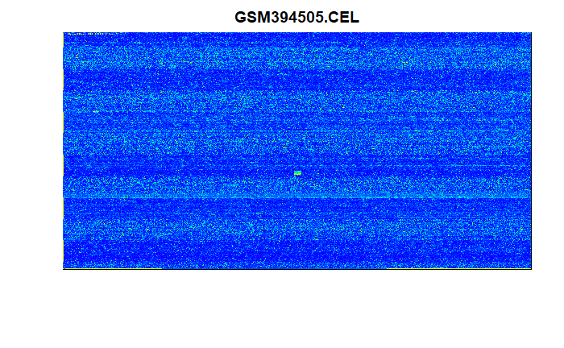
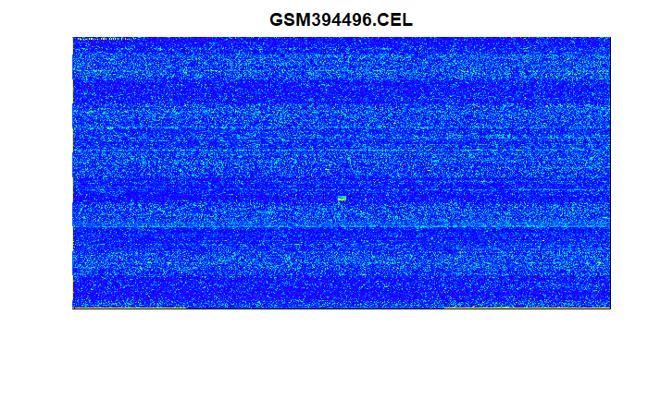
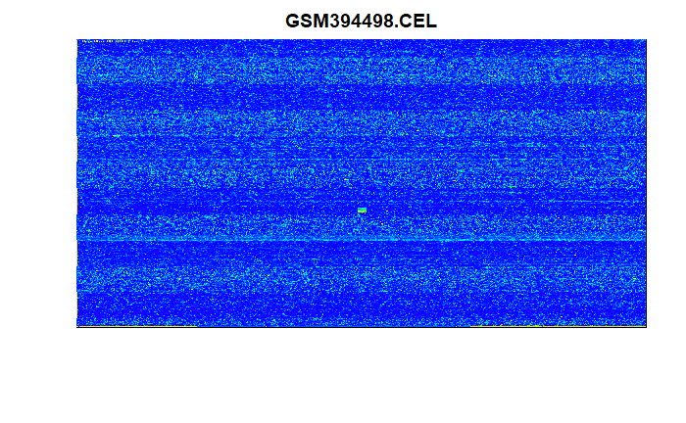
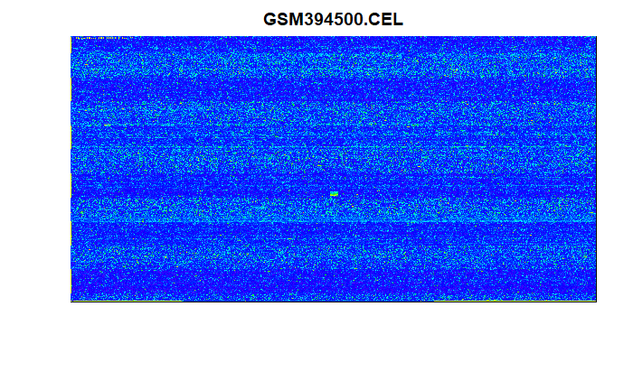
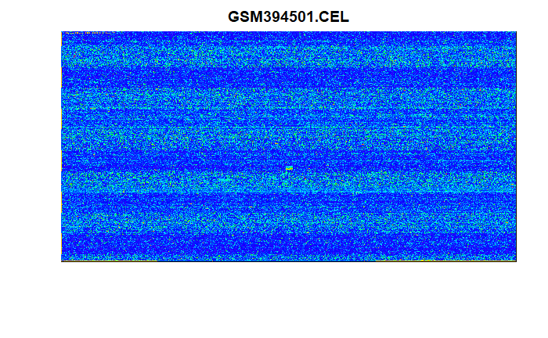



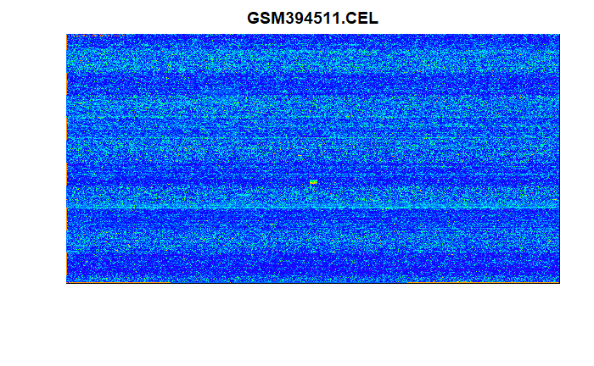
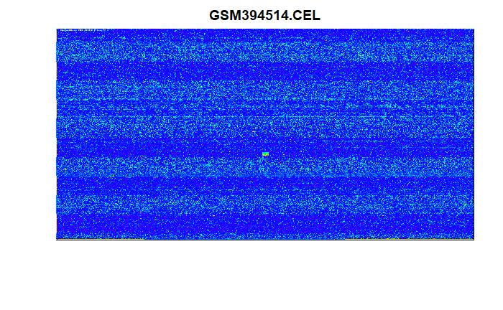
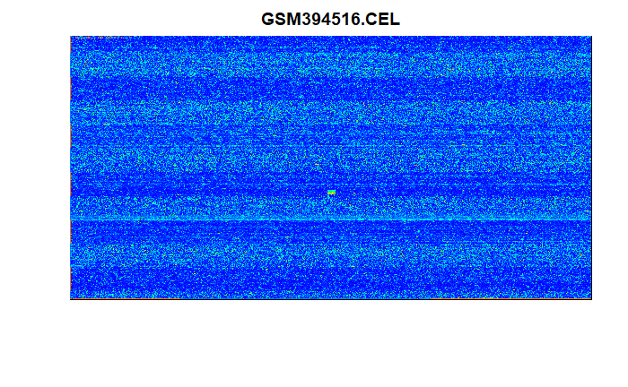
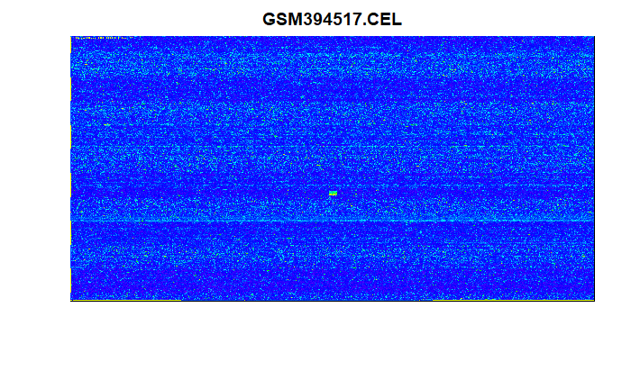
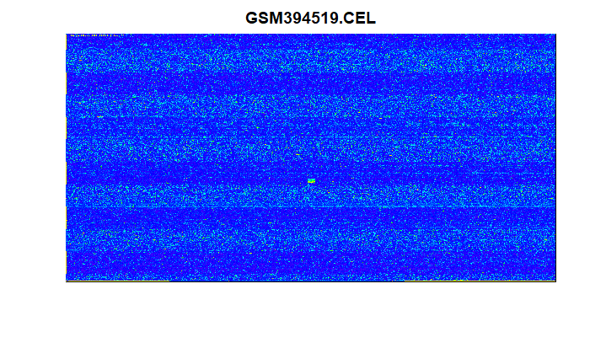

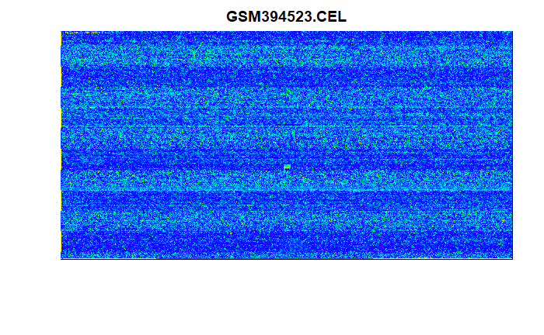
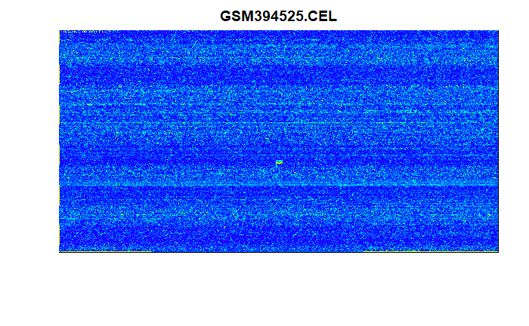


Quality control: Array surface images
No spatial artefacts, fingerprints, irregular dye or stripes
Slight differences in overall expression detection

Slide 13
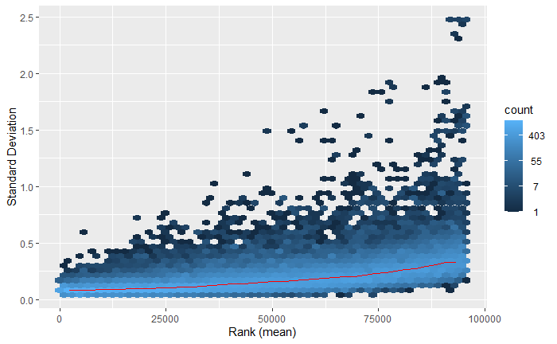
QC: MeanSD plot
Quality control of normalization method (vsn rma)
Normalization to correct systematic error and random fluctuation
MeanSD plot verifies normalization if rank(mean) and SD have almost no correlation
meanSD plot of vsn rma normalized gene expression (GSE15744)

Slide 14
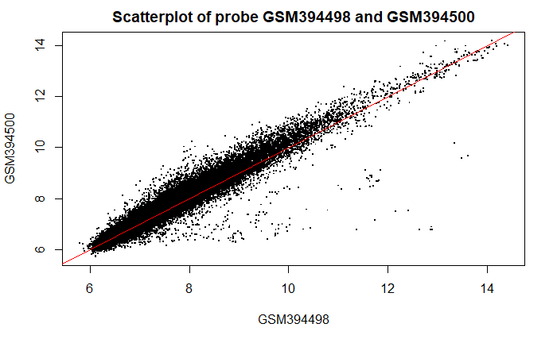
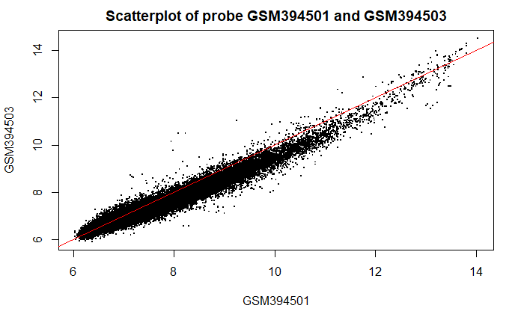
QC: Scatterplots
Comparison of two microarrays
Quality control of normalization method (vsn rma) through comparison
Microarrays of the same tissue and week should show similar expression (x=y)

Slide 15
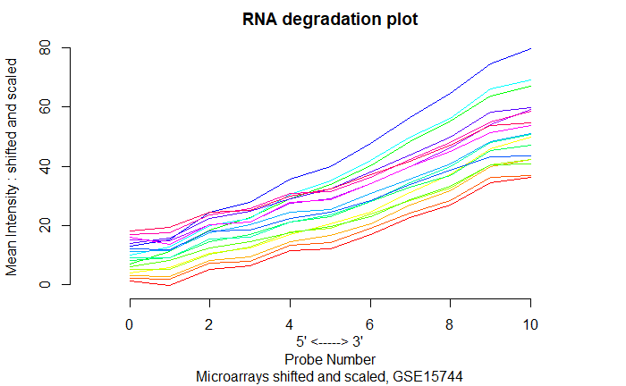
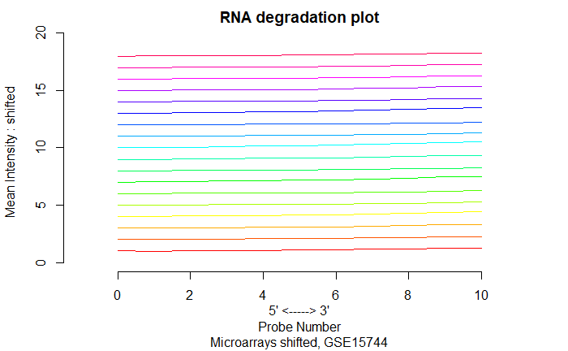
QC: RNA Degradation Plot
Hybridized RNA on microarrays degrades from 5‘ -> 3‘
Degradation should happen at an equal rate to deliver comparable results

Slide 16
TRA data: GTEx Database
ensembl. transcript | ensembl. gene | ensembl.symbol | ensembl.unigene | ensembl.entrez | ensembl.chrom | ensembl.start | tiss. number | tissues | max. tissue
ENST00000475157 | ENSG00000159388 | BTG2 | Hs.519162 | 7832 | 1 | 203305491 | 1 | Bladder/Ovary | Bladder
.
.
.
.
.
.
.
.
60,131 transcripts
54 tissues

Slide 17
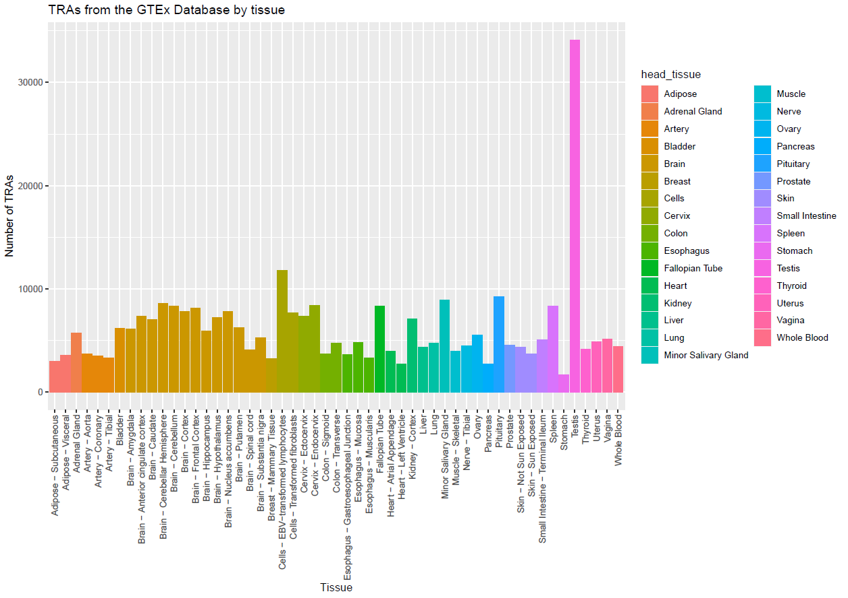

TRA data: GTEx Database
(GSE15744)

Slide 18
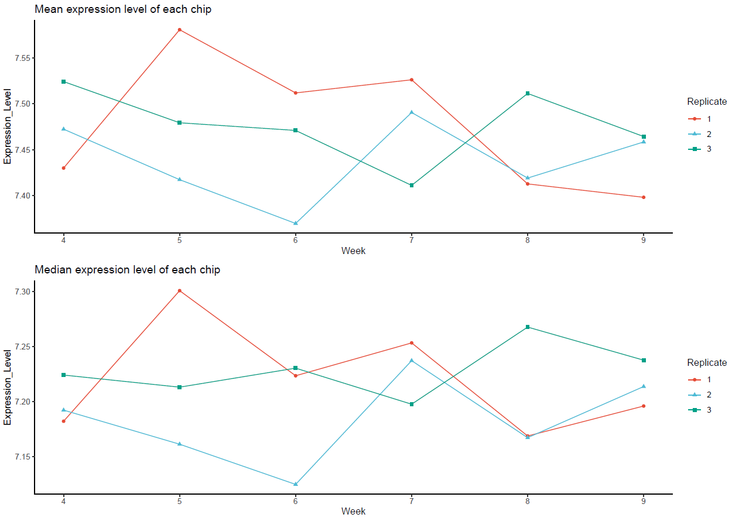
Gene expression over time
(GSE15744)
(GSE15744)

Slide 19
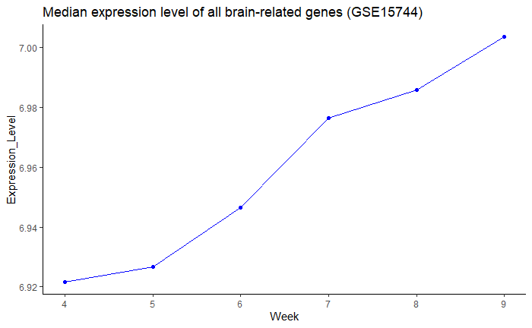
Differential gene expression

Slide 20
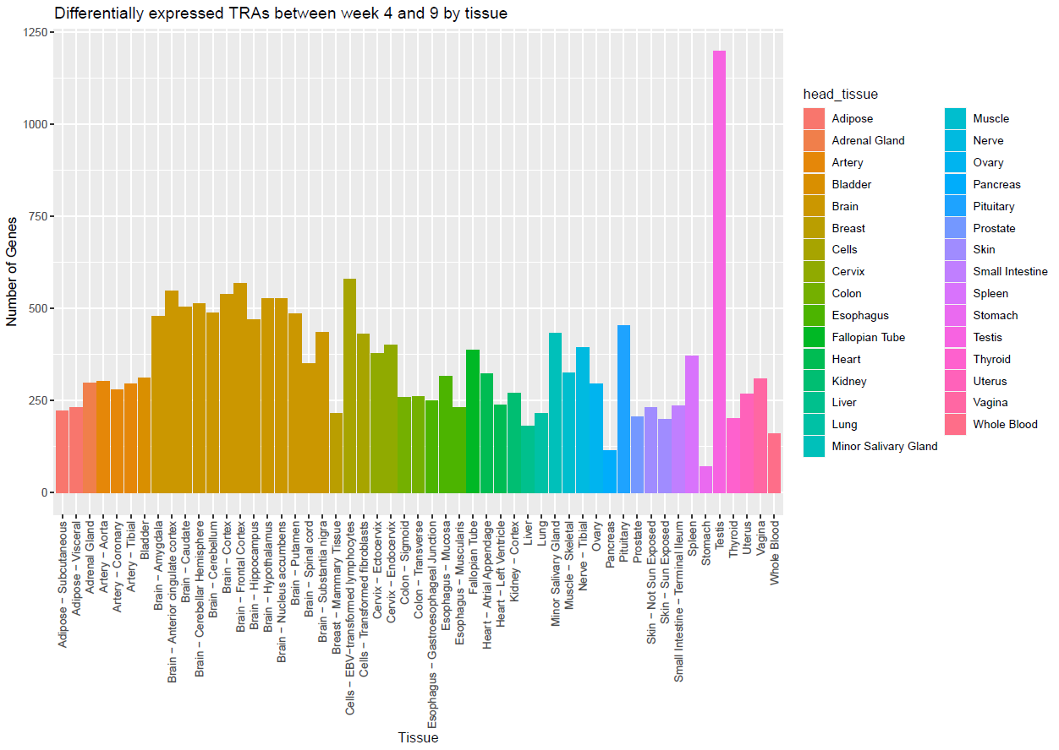
Differential gene expression
(GSE15744)

Slide 21


Hypothesis

Slide 22

Main Question
Gaining insight on human early organogenesis through TRA expression analysis

Slide 23




Three Hypotheses
Gaining insight on human early organogenesis through TRA expression analysis
TRAs can infer a timeline of organ development
similar to the results by Yi et al. 2010
Neural TRA expression patterns reflect morphological brain development
Specific TRAs can be used as key biomarkers for
the development of individual organs

Slide 24
Timeline

Slide 25
Timeline
Further Analysis
Screen for expression patterns using PCA and k-means clustering
Optional: explore chemokines
New Questions
Follow our research curiosity and explore new questions
Phase 1
31.05
Phase 3
28.06
Phase 5
19.07
Phase 2
14.06
Phase 4
05.07
Differential Gene Expression
Use limma analysis and
T-tests to determine differentially expressed genes for further analysis
Evaluate Results
Evaluate found data and connect findings with biological background
Final Steps
Compile all relevant data into report and final presentation
Notes:
Now that we have taken an in depth look at what we have achieved so far, lets switch our perspective around and take a look at where we want to go and what we want to achieve in the next two month.
Starting from today until the 31st of this month we are in phase one of our project: Differential gene expression. We are going to implement methods such as limma analysis and t-tests to further explore our data set and determine differentially expressed genes that will be of interest to us.
In Phase two, we will further analyze these genes of interest. We will do that by screening them for expression patterns using Methods like principal component analysis and k-means clustering. Optionally, we will also start exploring chemokines if there will be enough time for it. This second phase will end on the 14th of July. In Phase three, until the 28th of July we will start with the in depth evaluation of our found data. We plan on connecting our findings with the biological background and doing more research based on our findings. Phase four will be used to explore any new questions and ideas that will come up during the process of our project. We wil use this time to follow our research curiosity and personal interests. This will be going on until the 5th of July. Phase five will be used to take all necessary steps to conclude this project. We will compile all relevant data into a report and prepare a final presentation. This will be used to present all our gained knowledge to you. This last Phase will end on the 19th of July, just one day before we will conclude this project by holding our final presentation.

Slide 26
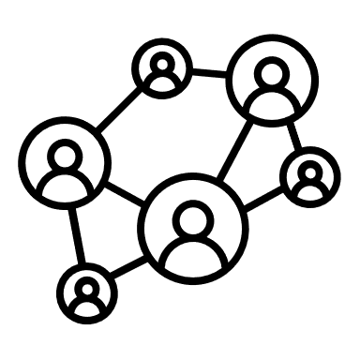
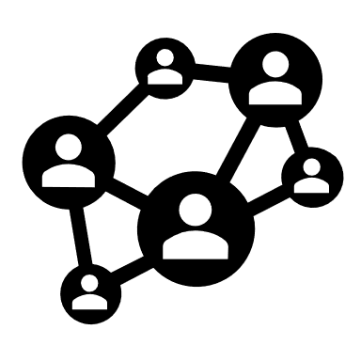








Building Blocks of our Teamwork
Staying connected
WhatsApp as main tool of communication
Tracking Progress
Log each meeting via Google Docs to keep overview of to-dos and topics
Tutorial Debriefing
Assess tutorial and collect immediate thoughts
Round Table
Tuesday 5 pm, in-depth discussion of tutorial and setting this week's tasks
Keeping it flexible
Remote meetings via Discord when needed
Notes:
Now that we have discussed what we want to achieve, it is also important to take a look at how we want to achieve that. To make this whole project a success, we have defined five building blocks for our teamwork. These are all aspects that we deem necessary for achieving our goals and succeeding as a team.
Fist and foremost: staying connected. Good Communication is key when it comes to teamwork, so we have chosen WhatsApp as our main tool of communication as it allows us to share information fast and easy. Second, we have decided on tracking our progress toroughly, so that we always have a clear overview of what we have already achieved and what still needs to be done. For the purpose of this, each team meeting is logged in a protocoll via google docs. This includes an in depth to-do list with tasks assigned to a specific person that will be checked upon the beginning of the next meeting.
Next, we have out tutorial debriefing. After every tutorial with you Ian, we meet up as a group to assess how productive the tutorial was. We also collect our imideate thoughts and ideas and any new insight that we gained. Now to one of the most important aspekts. The round table. Every Tuesday evening at five pm we meet at a conference room in the library and hold our weeks main meeting. This includes an in-depth discussion of our tutorial with Ian earlier in the day and exploring of our further developed ideas from the tutorial debriefing. We also recap what we achieved in the last week and distribute tasks for the coming week.
And last but definitely not least: keeping it flexible. There can always be unforeseen circumstances and unexpected problems that need immediate discussion. For instances as such we use discord as a tool to hold remote meetings so we can solve situations like that as fast as possible and move on from them.

Slide 27
Gaining inside on human early organogenesis through
TRA expression analysis

Slide 28


Appendix

Slide 29
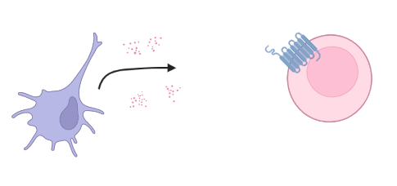
Chemokines
Group of small similar proteins
Chemoattractors
Bind to G-Protein Coupled Receptors (GPCR) → induce signaling cascade
Biorender by Joshua Eigenmann
Notes:
But what are chemokines ?
Small groupe of proteins with similar structure.
Chemoattractors: -> cells (dendritic cells) rerlease them, effector cells (leukocytes) move to the origin of release
->chemokines bind to GPCR and induce signaling cascade
They play an important role in embryonic development, which is unknown.

Slide 30
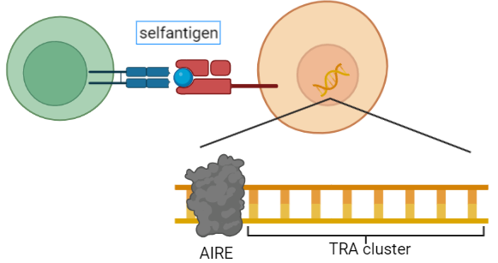
Tissue restricted antigens (TRAs)
Genes for self-antigens
Ordered in autoimmune regulator (AIRE) controlled cluster
Genes which are expressed more than 5x the median in less than 5 tissues
Biorender by Joshua Eigenmann
Notes:
Another important issue are TRAs
Functional immune cells are necasssary to prevent infections
Shouldn’t react against selfantigens -> negative control in thymus
Medullary thymic epithelial cells (mTECs) present slef-antigens on their surface, reacting immune cell will be removed
Tissue restricted antigens (TRAs) code for selfantigens
TRAs are ordered in cluster which are controlled by the transcriptionfactor Autoimmune Regulator (AIRE)
Genes more than 5x the median in less than 5 diffrent tissues expressed

Slide 31
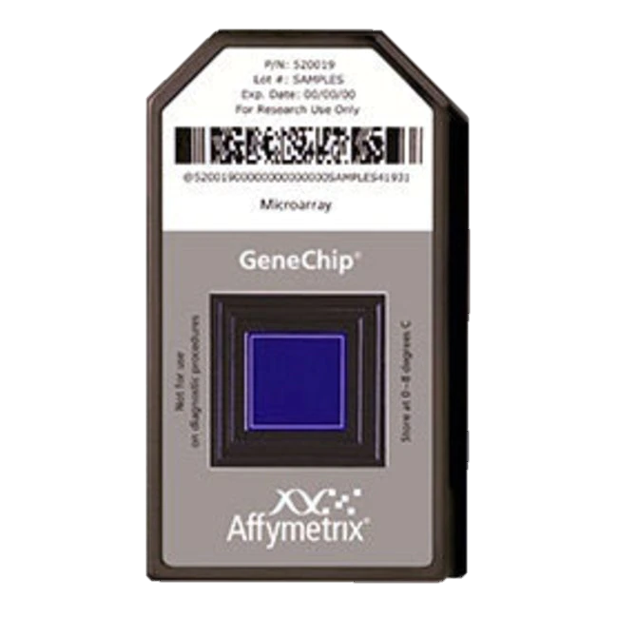
Quality Control (QC)
Affymetrix Human Genome U133 Plus 2.0 Array
Expression analysis of over 47,000 transcripts and variants through comparison of 54,000 probe sets
Detection sensitivity 1:100,000
Gen sequences of probe sets are selected from GenBank®, dbEST, and RefSeq
Complementary oligonucleotide probes are synthesized in situ on the array
www.thermofisher.com/

Slide 32
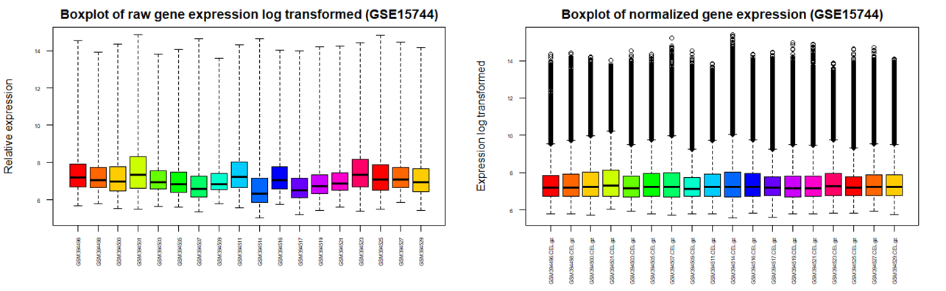
QC: Boxplots
Comparison of all microarrays
data visualization, Quality control of normalization method (vsn rma)
Shows median, quantiles and outliners

Slide 33
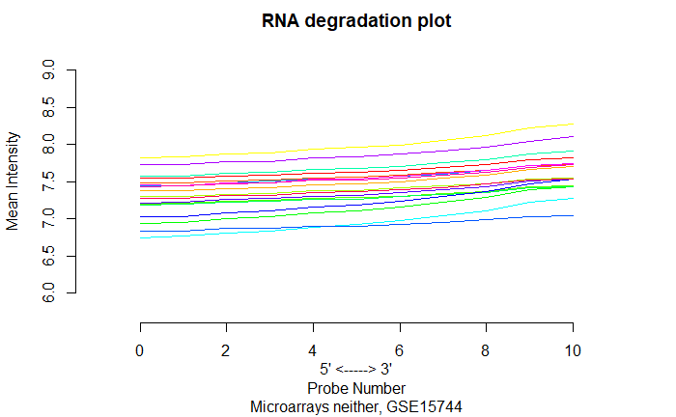
QC: RNA Degradation Plot
Hybridized RNA on microarrays degrades from 5‘ -> 3‘
Degradation should happen at an equal rate to deliver comparable results

Slide 34
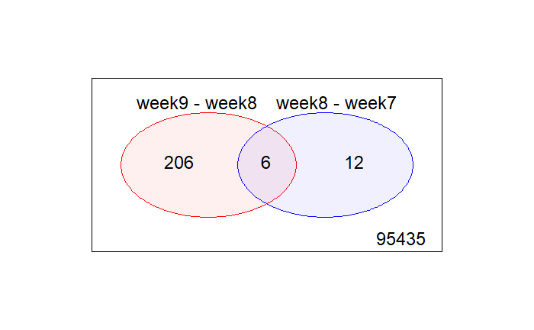
Differential gene expression
Venn Diagram of differential gene expression between weeks 7,8,9 (GSE15744)

Slide 35
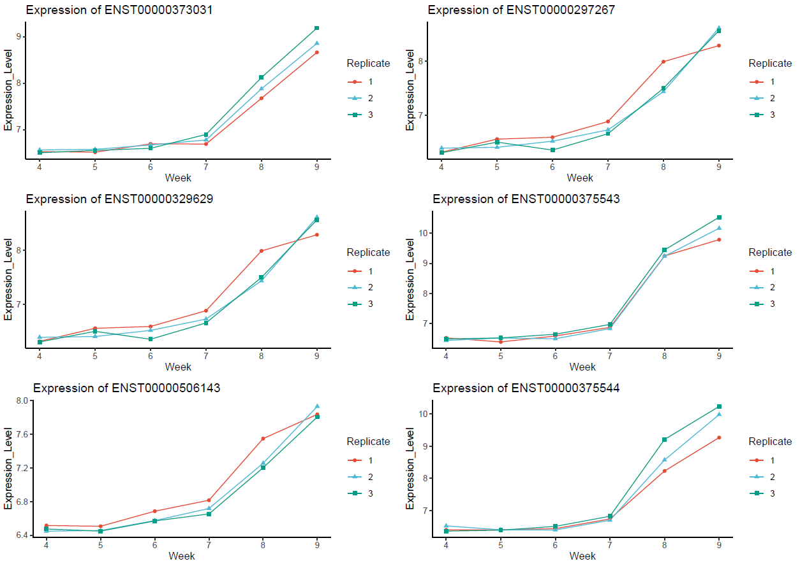
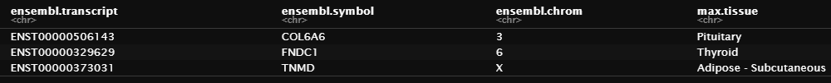
Potential target genes

Slide 36
Potential target genes

Slide 37
Biological background

Slide 38
Dataset

Slide 39
Milestones/Timeline

Slide 40
Team/Roles

